Slide 1



GESTURE2GLOBE
Gestures to Global Languages
Application Of Deep Learning: Course Project Review
PRESENTED BY:
Raghu Hasan Bokam
Sharon Roshini Swaminathan
Jayasri Suresh Vani
Mahalakshmi

Slide 2
INTRODUCTION
Real-time ASL-to-speech translation system enabling communication between sign language users and non-signers.
End-to-end pipeline: hand gesture recognition → word detection → sentence formation → natural speech synthesis → Audio generation
PIPELINE :
1) Detect words from body , left hand and right hand and face key points (TGCN Model ).
2) Sentence Generation: Form grammatical sentence from words. (FLAN-T5 base).
3) Audio generation from the formed sentence via Piper TTS.

Slide 3
SYSTEM OVERVIEW
Frontend (React + Vite):
Video upload interface (mp4, webm, avi, mov, mvk)
Live Webcam capture with real-time frame processing
MediaPipe Hands integration for letter detection visualization
Features:
Dual-mode operation (Upload/Live), real-time feedback, audio playback
Backend (Flask REST API):
MediaPipe Pose extraction (OpenPose BODY_25 format mapping)
ONNX Runtime inference engine
Session-based letter detection management
Audio file serving and management.

Slide 4
MODEL WORKING
Word Recognition: TGCN (Temporal Graph Convolutional Network)
Dataset: 100 words from WLAS-2000
Input take: 55 key points x 50 temporal samples (13 body + 21 left hand + 21 right hand)
Architecture: 20 stage graph convolution with 64 hidden units
Sentence Formation: (FLAN-T5-Large + GPT-2)
FLAN-T5-Large: Generates multiple candidate sentences from the input words.
GPT-2: Calculates perplexity for each candidate to measure fluency.
The sentence selects the sentence with the best combination of :
Word coverage, Word order preservation, Low Perplexity, Appropriate length

Slide 5
MODEL WORKING
3. Text-to-Speech: (Piper TTS)
Models: English - en_US-lessac-medium.onnx, Spanish - es_Es-sharvard-medium.onnx
Output: High quality neural speech synthesis (WAV format)
4. Letter Detection: (Random Forest Classifier)
250 decision trees
Input: (63 dimensional) Landmark Vectors
Output: 24 Classes : Letters A-I and K-Y (excluding J and Z, which require motion tracking)
Label encoder maps: 0 → ‘A’, 1-> ‘B’ , .... 23 → ‘Y’

Slide 6
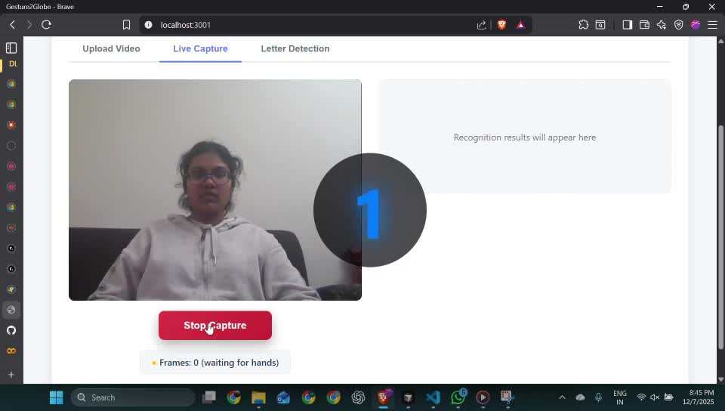
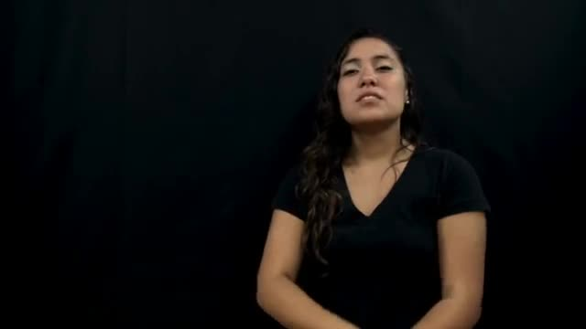
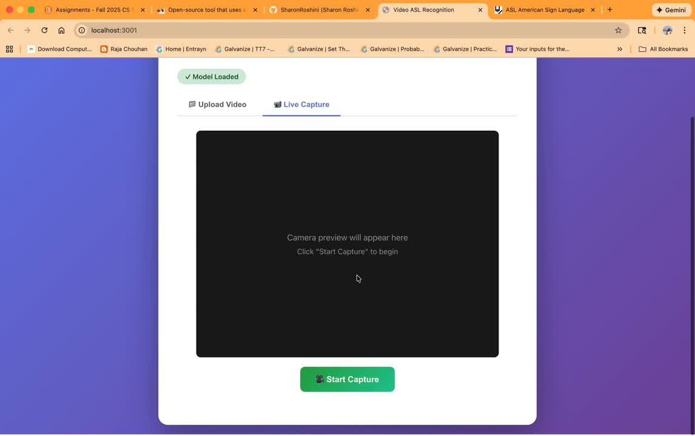
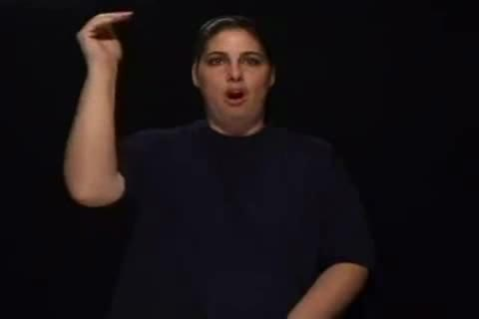
DEMO
Medicine
Tall

Slide 7
DEMO
Link: https://gesture2globe-314132844324.us-central1.run.app

Slide 8
TRAINING SUMMARY
Classes | Accuracy
asl100 | 87
asl300 | 79
asl1000 | 72 (Pre-trained accuracy)
asl2000 | 59 (Pre-trained accuracy)
Hugging face deployment limitation: Model accuracy decreased due to computational constraints and environment differences in the cloud deployment platform
I3d Model: Requires substantial computational resources (GPU memory and processing power) as it processes raw video frames directly without pose key point extraction.

Slide 9
Good & Bad Experiences
Good Experience
Challenging Experience
Cross-module flow solid: Live capture → key points → ONNX word model → FLAN-T5 sentence → Piper TTS now runs end-to-end.
Problem-solving: Resolved version mismatches, ONNX runtime setup, frame batching for live capture, optimizing pose point extraction.
UX polish: Camera access limited only when detecting signs, clear Start/Stop, frame point extraction only during hand gestures, setting minimum frame requirement to avoid mistaken hand movements and quicker feedback on missing frames.
Effective in-person and Virtual communication and collaboration among all group members.
Limited references: Only one relevant reference to guide architecture and threshold choices, and it did not directly address live detection.
Data quality: Some training videos were mislabeled or partially cropped, lowering model confidence.
Dialect drift: Regional sign differences and multiple signs for the same word reduced model generalization.
Training time: ASL100 training took ~3 days on CPU, making iteration slow and limiting experimentation with ASL2000.

Slide 10
Improvements
Difficulties
What can be improved?
Hallucinations in sentence formation: FLAN-T5 occasionally generated off-topic text, requiring strong constraints to keep outputs on-task.
Overlapping gestures: Multiple words share similar signs; some overlaps weren’t distinguishable, especially with single-hand capture.
Two-hand visibility: Some signs need both hands, but captures often showed only one hand or missed occluded motion.
Variable video lengths: Clip durations varied widely, so frame counts were inconsistent and harder to normalize.
Letters vs motion: Static letters worked fine; motion-heavy signs (J/Z or two-hand motions) were less reliable.
Better Models: Integrating more advanced computer vision models would strengthen recognition accuracy and better handle subtle variations across signs.
Larger Vocabulary: Increasing the vocabulary would let the system understand more words and phrases.
Custom Dataset: Creating and training on a custom dataset would improve accuracy, especially for signs that are harder to capture or less common.

Slide 11
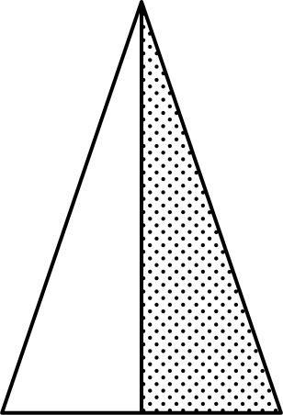
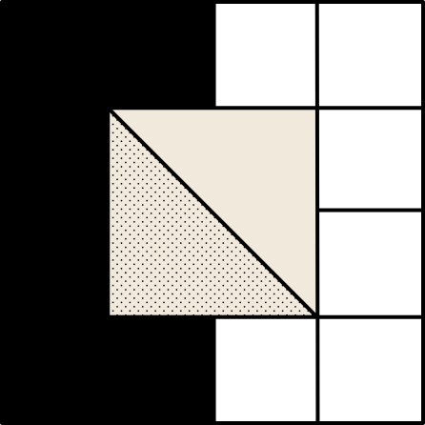
FUTURE WORKS
Accent Implementation
Real-Time Optimization
Personalized Dataset
Instant word detection

Slide 12
Thank you
Applications of Deep Learning

